Slide 1

smart HOME
Preparation By:
1- Omar Ahmed Dawood El Sayed
2- Muhammed Essam Abbas Abdullah
TEAM 2.

Slide 2
Introduction
Our project here is making a Smart Home from scratch.
Firstly, What is a smart home?
A smart home refers to a convenient home setup where appliances and devices can be automatically controlling itself by interfacing with the Environment surrounding it by using Micro-controllers and sensors.

Slide 3
WORKING PRINCIPLES
Our project starts before entering the home itself :)
First thing you will interact with is a button, keypad, LCD and 7- Segment Display.
To enable the keypad and LCD you must press on the button,
Now the LCD will display "Welcome to the Smart home", Then waiting for 5 seconds.
After that, the 7-Segment will display number 3.

Slide 4
CONT.WORKING PRINCIPLES
This number indicates the number of trials you must enter before entering the correct username or password.
At the same time, the 7-Segment is on, The System will ask you to enter the username of the home
After entering the username, you will be asked to enter the password.
If one of them isn't what the home expected, the number on the Segment will be decremented by 1 until it reaches to 0.
If it reaches to 0 the system will be closed, and you can open it again by pressing the button.

Slide 5
CONT.WORKING PRINCIPLES
If you press the button at any time except those times, it will do nothing.
the Button is only enabled at every start of the system and after failing the 3 trials.
If you entered both the username and password correctly , the LCD will be cleared and then display "Opening Door...".
the door will start to open using a servo motor at reasonable speed.

Slide 6
CONT.WORKING PRINCIPLES
After it's opened entirely the LCD will be cleared and then it will display the Temperature and the Number of LEDS that is ON in the home.
Inside the home we have 8 LEDS and a fan.
The fan is expected to work if only the temperature is higher than 26 degree Celsius.
The Intensity of the light inside the home from the surrounding Environment is what controls the number of LEDS that will be ON.

Slide 7
CONT.WORKING PRINCIPLES
For example:
If we are at the noon, 12 PM, the sun is at its peak and the light is too intense then there is no any LEDS will be opened
else If we are at the middle of the night with true darkness, 12am for example, all the LEDS will be opened.
If we are in between considering the intensity of the light, then the number of LEDS opened will be adjusted according to the Intensity
In other words, the relationship between the light intensity and the number of LEDs opened is Inversely proportional.

Slide 8
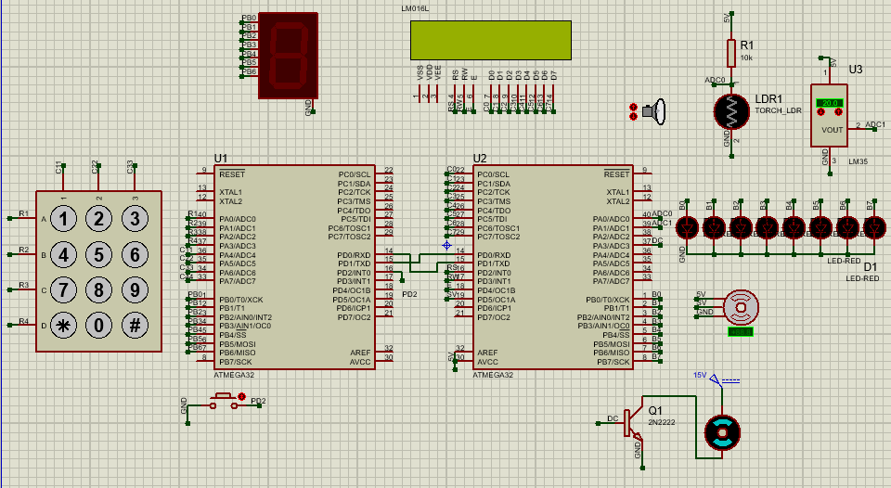
HARDWARE SCHEMATIC

Slide 9

VIDEO OF SIMULATION

